Slide 1
PROJECT TITLE:RESPONSIVE PORTFOLIO
AUTHOR:V.SWETHA
COURSE:BSC.COMPUTER SCIENCE
DATE:08.09.2025

Slide 2
PROBLEM STATEMENT
In today’s digital era, having an online presence is crucial for personal branding, career growth, and professional opportunities. Many individuals lack a well-structured platform to showcase their skills, projects, and achievements. A personal portfolio website provides a centralized space to present work, demonstrate technical abilities, and create a strong impression on recruiters, clients, or collaborators.

Slide 3
PROJECT OVERVIEW
The project focuses on developing a personal portfolio website using HTML, CSS, and JavaScript. The portfolio highlights academic background, technical skills, certifications, and project work in an interactive and user-friendly manner. It includes visually appealing layouts, smooth transitions, and responsive design to ensure accessibility across devices.

Slide 4
END USERS
Students & Professionals → To showcase their skills, resumes, and achievements.
Recruiters/Employers → To evaluate a candidate’s work and expertise.
Clients → To explore services or freelance work offered by the developer.
General Audience → To know more about the person and their portfolio.

Slide 5
TOOLS AND TECHNOLOGIES
Frontend: HTML5, CSS3, JavaScript
Editor/IDE: VS Code / Sublime Text / Notepad++
Version Control: Git & GitHub (for hosting and version management)
Deployment: GitHub Pages / Netlify / Vercel

Slide 6
FEATURES AND FUNCTIONALITY
Fully responsive design (desktop, tablet, mobile)
Smooth CSS transitions and hover effects
Project showcase with links to live demos and GitHub repos
Downloadable resume option

Slide 7
PORTFOLIO DESIGN AND LAYOUT
Homepage: Introduction, profile picture, and tagline
About Me: Personal information, background, and career goals
Skills Section: List of technical and soft skills with progress bars or icons
Projects Section: Showcase completed projects with descriptions and

Slide 8
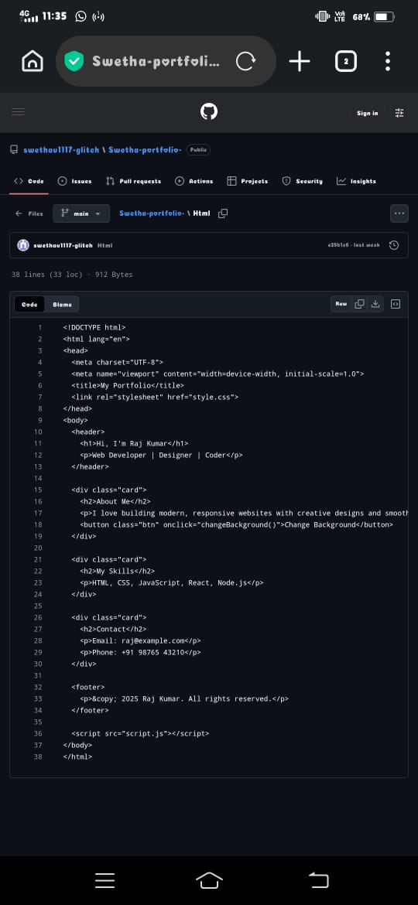
RESULT AND SCREENSHOT
Hi... I'm Swetha.v

Slide 9
CONCLUSION
The personal portfolio website successfully provides a modern, accessible, and visually appealing way to showcase professional achievements and technical skills

Slide 10
GITHUB LINK
https://github.com/swethav1117-glitch/Swetha-portfolio-/tree/main

